Slide 1

SecureCoding
Logging

Slide 2
logging
Collection and storing of data over a time period for analysis
Can be used to gain insights, resolve bugs and detect problems of an application
In its simplest form, you have probably used console.log to log data to the command line for debugging in BED.

Slide 3
Why log
Debugging – Document the steps leading up to the error
Security Audits – Detecting and logging suspicious activities or important activities/events
With a large system, logging becomes even more important due to the complexity of tracking and detecting

Slide 4
What to log
Timestamp or log entry.
Timing data for your request.
Request endpoint data, such as paths: “/users” or verbs: GET, POST, PUT, DELETE
IP of the requesting party.
Exceptions

Slide 5
How to log
In its simplest form, you can manually write code and write the required info to the console, file or database
Libraries exist in the internet specifically for logging: Morgan, Winson, Log4JS etc
We will focus on Morgan library

Slide 6
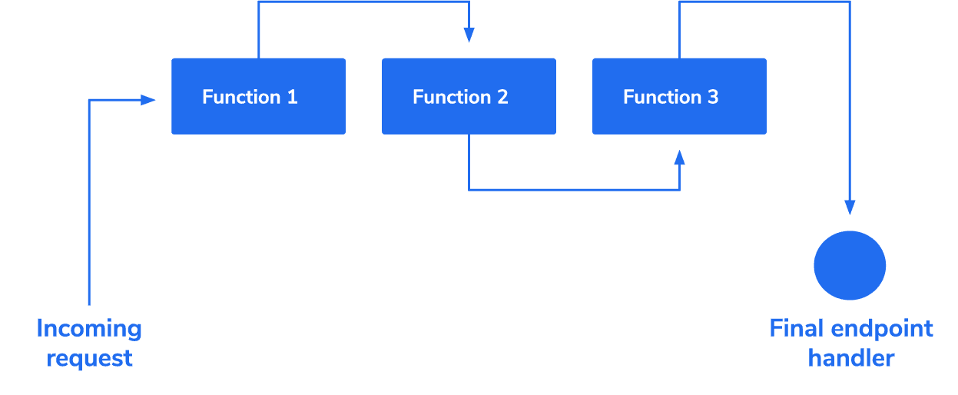
Morgan
HTTP request logger middleware for node.js
It simplifies the process of logging requests to your application.

Slide 7
Using morgan
https://www.npmjs.com/package/morgan
Install with npm install morgan --save
Import library with var morgan = require('morgan')
API: morgan(format, options)
Create a new morgan logger middleware function using the given format and options. The format argument may be a string of a predefined name, a string of a format string, or a function that will produce a log entry.
The format function will be called with three arguments tokens, req, and res, where tokens is an object with all defined tokens, req is the HTTP request and res is the HTTP response. The function is expected to return a string that will be the log line, or undefined / null to skip logging.

Slide 8
Morgan pre-defined tokens
Token | Value
:date | The current date and time in UTC.
:http-version | The HTTP version of the request.
:method | The HTTP method of the request.
:referrer | The Referrer header of the request.
:remote-addr | The remote address (ip) of the request
:remote-user | The user authenticated as part of Basic auth for the request.
:req[header] | The given header of the request.
:res[header] | The given header of the response.
:response-time | The time between the request coming into morgan and when the response headers are written, in milliseconds
:status | The status code of the response.
:total-time | The time between the request coming into morgan and when the response has finished being written out to the connection, , in milliseconds
:url | The URL of the request.
:user-agent | The contents of the User-Agent header of the request.

Slide 9
Predefined log formats
Token | Value
combined | Apache standard combined format
common | Apache standard common format
dev | A color-coded (by request status) log format
short | Shorter than the default format
tiny | Even shorter, just the response time and a few items

Slide 10
predefined log formats with morgan
var morgan=require('morgan');
…
app.use(morgan("combined”));
…

Slide 11
Using predefined tokens
Specify the tokens you want in your log format:
…
app.use(morgan(':method :url :date'));
..
Token 1 …. Token n

Slide 12
Creating custom tokens
morgan.token(‘myToken', function(req,res){
…
return …;
});
Custom Token name
Function that returns some value representing token output in log

Slide 13
Applying custom token
app.use(morgan(‘:myToken :method :url :date'));
Apply and test the code and observe output in console
Custom Token, with : and name of token

Slide 14
Applying logging to file
Using fs libray to create a file stream and applying it to morgan
var fs=require(‘fs’);
… const appLogStream = fs.createWriteStream(path.join(__dirname, 'app.log'), { flags: 'a' })
…
app.use(morgan("combined”, { stream: appLogStream}));
…
Append mode to file
Specify stream in options with file stream

Slide 15
Log file rotation
The log file can grow to a very large size for applications hosted on the cloud
Need to create multiple log files, eg one each day (depending on needs of application)
Make use of the rotating-file-stream module
npm install rotating-file-stream --save

Slide 16
Log file rotation
var rfs = require('rotating-file-stream');
// create a rotating write stream
var appLogStream = rfs.createStream('access.log', {
interval: '1d', // rotate daily
path: path.join(__dirname, 'log') //write to a subdir log
})
…
app.use(morgan("combined”, { stream: appLogStream}));

